Slide 1
SQL PROJECT
Mentorness Internship Program
Project Name: Decode Gaming Behaviour
By
VENKADESH V

Slide 2
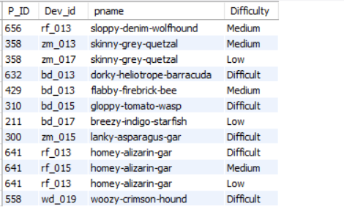
Question 1 Extract `P_ID`, `Dev_ID`, `PName`, and `Difficulty_level` of all players at Level 0.
Create database: create database game_analysis;
Use database : use game_analysis;
select l.P_ID, l.Dev_id,p.pname, l.Difficulty from level_details2 as l
join player_details as P on l.P_ID = P.P_id
where level = 0;

Slide 3
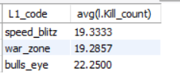
Question 2 Find `Level1_code`wise average `Kill_Count` where `lives_earned` is 2, and at least 3 stages are crossed.
select p.L1_code, avg(l.Kill_count) from player_details as p
join level_details2 as l on p.P_ID = l.P_id
where l.lives_earned = 2 and l.stages_crossed >=3
group by p.l1_code;

Slide 4
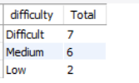
Question 3 Find the total number of stages crossed at each difficulty level for Level 2 with players using `zm_series` devices. Arrange the result in decreasing order of the total number of stages crossed.
select difficulty, count(stages_crossed) as Total from level_details2
where level = 2 and Dev_Id like 'zm%%'
group by difficulty
order by Total desc;

Slide 5
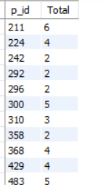
Question 4 Extract `P_ID` and the total number of unique dates for those players who have played games on multiple days.
select p.p_id, count(distinct( l.TimeStamp)) as Total from player_details as p
join level_details2 as l on p.P_ID = l.P_id
group by P.P_id
having Total>1;

Slide 6
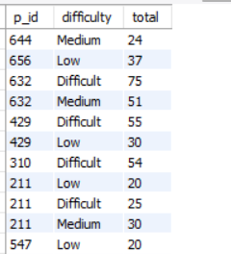
Question 5 Find `P_ID` and levelwise sum of `kill_counts` where `kill_count` is greater than the average kill count for Medium difficulty.
select p_id, difficulty,sum(kill_count) as total from level_details2
where kill_count > (select avg(kill_count) as average from level_details2 where difficulty = "Medium")
group by P_id,difficulty;

Slide 7
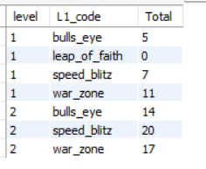
Question 6 Find `Level` and its corresponding `Level_code`wise sum of lives earned, excluding Level 0. Arrange in ascending order of level.
select l.level,p.L1_code, sum(l.lives_earned) as Total from level_details2 as l
join player_details as p on l.P_id = p.P_id
where l.level <>0
group by l.level,p.l1_code
order by level asc;

Slide 8
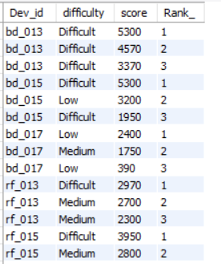
Question 7 Find the top 3 scores based on each `Dev_ID` and rank them in increasing order using `Row_Number`. Display the difficulty as well.
with demo as (select Dev_id,difficulty, score ,
row_number() over (partition by dev_id order by score desc) as Rank_
from level_details2)
select Dev_id,difficulty,score,Rank_ from demo
where rank_<=3;

Slide 9
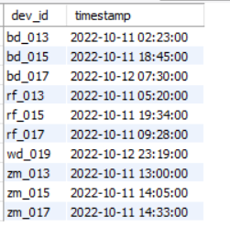
Question 8 Find the `first_login` datetime for each device ID.
with first_login as(
select * , row_number() over (partition by dev_id order by timestamp) as Rank_ from level_details2)
select dev_id,timestamp from first_login
where Rank_ = 1;

Slide 10
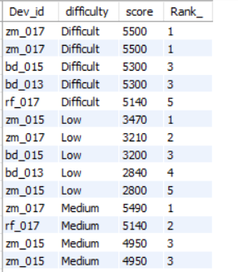
Question 9 Find the top 5 scores based on each difficulty level and rank them in increasing order using `Rank`. Display `Dev_ID` as well.
with Top_5 as(select Dev_id,difficulty, score ,
rank() over (partition by difficulty order by score desc) as Rank_
from level_details2 )
select Dev_id,difficulty,score,Rank_ from Top_5
where rank_<=5;

Slide 11
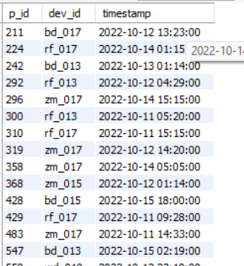
Question 10 Find the device ID that is first logged in (based on `start_datetime`) for each player (`P_ID`). Output should contain player ID, device ID, and first login datetime
with first_login as (select * , row_number() over (partition by p_id order by timestamp) as Rank_
from level_details2)
select p_id,dev_id,timestamp from first_login
where Rank_ = 1;

Slide 12
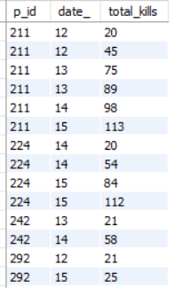
Question 11 For each player and date, determine how many `kill_counts` were played by the player so far. A)Using window functions
select p_id, day(timestamp)as date_ , sum(kill_count) over(partition by p_id order by timestamp ) as total_kills
from level_details2;

Slide 13
Question 11 For each player and date, determine how many `kill_counts` were played by the player so far. B) Without window functions
select a.p_id, day(a.timestamp) as date_, sum(b.kill_count) as total_kills
from level_details2 as a
join level_details2 as b on a.p_id = b.p_id
where a.timestamp >= b.timestamp
group by a.p_id, a.timestamp
order by a.p_id;

Slide 14
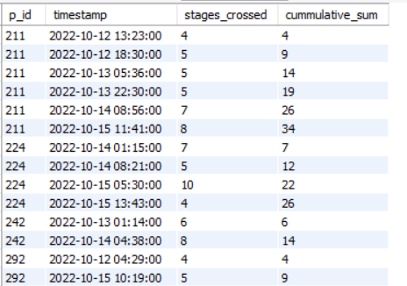
Question 12 Find the cumulative sum of stages crossed over `start_datetime` for each `P_ID`, excluding the most recent `start_datetime`.
select p_id,timestamp,stages_crossed,sum(stages_crossed)
over(partition by p_id order by timestamp rows between unbounded preceding and current row) as cummulative_sum
from level_details2;

Slide 15
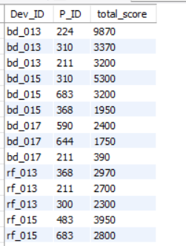
Question 13 Extract the top 3 highest sums of scores for each `Dev_ID` and the corresponding `P_ID`.
WITH top_3 AS (SELECT Dev_ID, P_ID,SUM(score) AS total_score,
ROW_NUMBER() OVER (PARTITION BY Dev_ID ORDER BY SUM(score) DESC) AS ranked
FROM level_details2
GROUP BY Dev_ID,P_ID)
SELECT Dev_ID,P_ID,total_score FROM top_3
WHERE ranked <= 3;

Slide 16
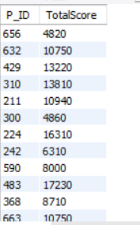
Question 14 Find players who scored more than 50% of the average score, scored by the sum of scores for each `P_ID`.
SELECT P_ID, TotalScore
FROM (SELECT P_ID, SUM(Score) AS TotalScore FROM level_details2
GROUP BY P_ID) AS PlayerScores
WHERE TotalScore > ( SELECT AVG(TotalScore) * 0.5 FROM ( SELECT SUM(Score) AS TotalScore
FROM level_details2
GROUP BY P_ID) AS AvgScore );

Slide 17
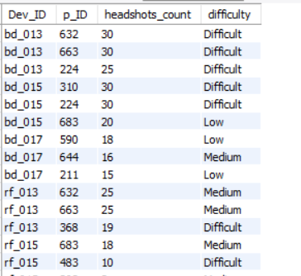
Question 15 Create a stored procedure to find the top `n` `headshots_count` based on each `Dev_ID` and rank them in increasing order using `Row_Number`. Display the difficulty as well.
DELIMITER //
CREATE PROCEDURE heatshotcount(IN n INT)
BEGIN
SELECT Dev_ID, p_ID, headshots_count, difficulty
FROM (SELECT Dev_ID, p_ID, headshots_count, difficulty,
ROW_NUMBER() OVER (PARTITION BY Dev_ID ORDER BY headshots_count DESC) AS Rank_
FROM level_details2) AS RankedHeadshots
WHERE Rank_ <= n;
END //
DELIMITER ;
call heatshotcount(3) -- Replace 3 with the desired value of n

